Slide 1
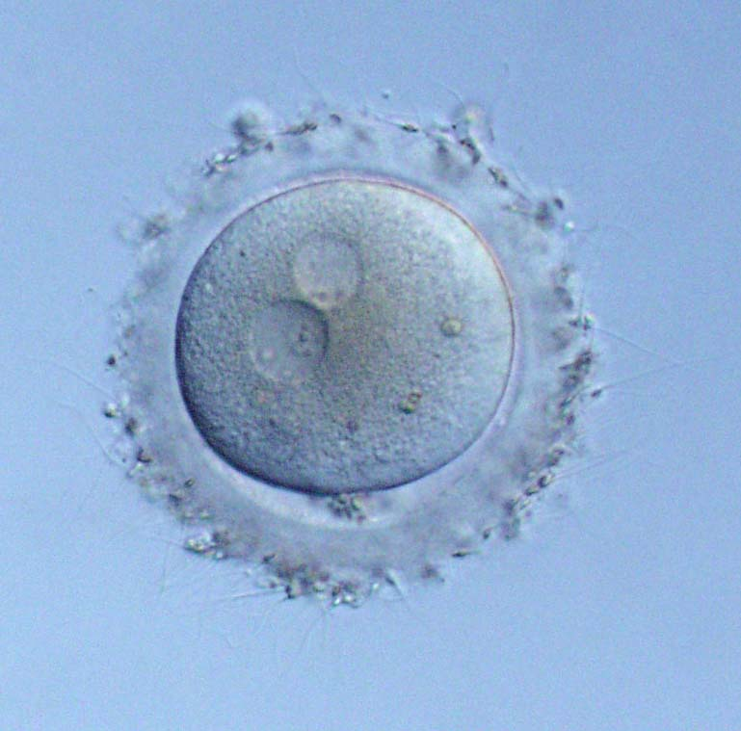
Human germline genome editing: Most important feature
The use of hGGE for disease prevention may be acceptable in a country because it intends to safeguard the genetically-related child’s right to an open future. However, hGGE can have a systemic impact on the embryos, fetuses, and children with human rights.
By the courtesy of Dr. Yasuyuki Mio, MIO Fertility Clinic
Double-edged sword effect

Slide 2

Human germline genome editing: Three issues
Healthy
Normal
development
Born
healthy
①Long-term
follow-up
Parents wanting
a genetically-related
healthy child
Miscarriage
Affected
Affected
③Issues of
human rights
Affected
②Abortion
Transfer to uterus
ICSI
Zygotes
Blastocysts
A selected embryo
Enzyme
injection
PGD
Adapted from Ishii T. Curr Opin Endocrinol Diabetes Obes. 2017;24:418-423.

